Slide 1

Startup Failures
An Analytical Report on Startup Failures
Slytherin Co.
Ahmad, Chika, Atefah

Slide 2










Project Overview: Why Are We Here?
The Problem: Despite increasing funding, startups continue to fail. If not funding, then what?
The Objective: Investigate whether funding improves survival rates and identify sector-specific failure reasons.
The Goal: Provide data-driven policy recommendations to enhance startup success.

Slide 3





Roadmap
Data Collection
Data Cleaning
Data Management
Data Visualization
Findings
Data collected from Kaggle.
Cleaned data on Python.
Data modeled on MySQL.
Data visualized on Python
Findings presented on Powerpoint

Slide 4
Business Hypothesis:
Hypothesis Nº1
Hypothesis Nº2
Hypothesis Nº3
Hypothesis Nº4
Fundings
Regulations
Failure Reasons
Timing & Economic Conditions
Startups with higher initial funding have a lower probability of failure.
The most common reason for failure is poor market fit, rather than funding
Startups in highly regulated industries (e.g. Finance, Healthcare) have higher failure rates due to compliance challenges.
Startups fail during economic downturns and recessions - Covid

Slide 5
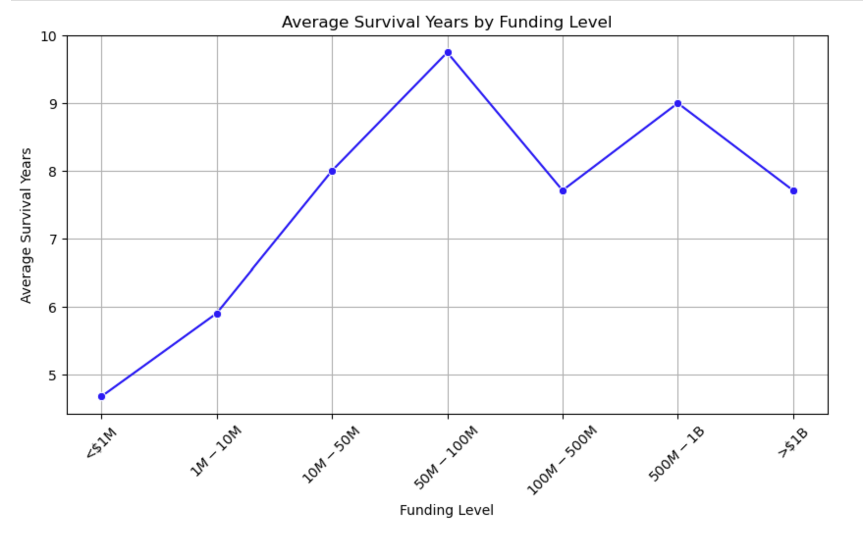
H. Nº1: Fundings:
Are low-funded startups failing more?
Does higher funding reduce failure rates?

Slide 6
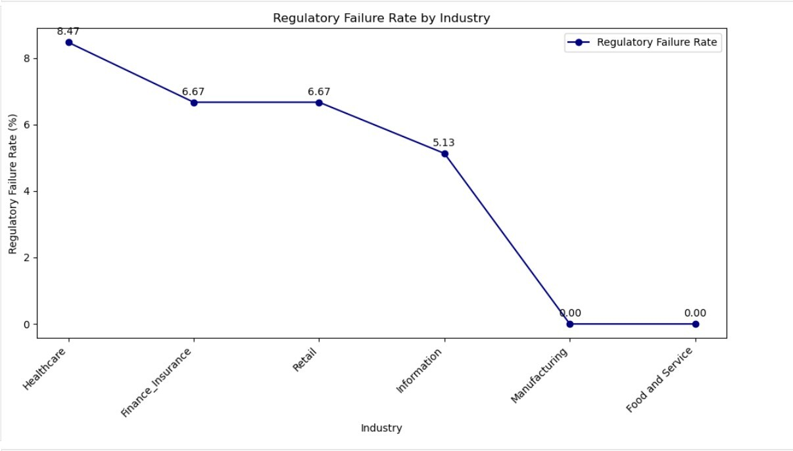
H. Nº2: Regulations (A):

Slide 7
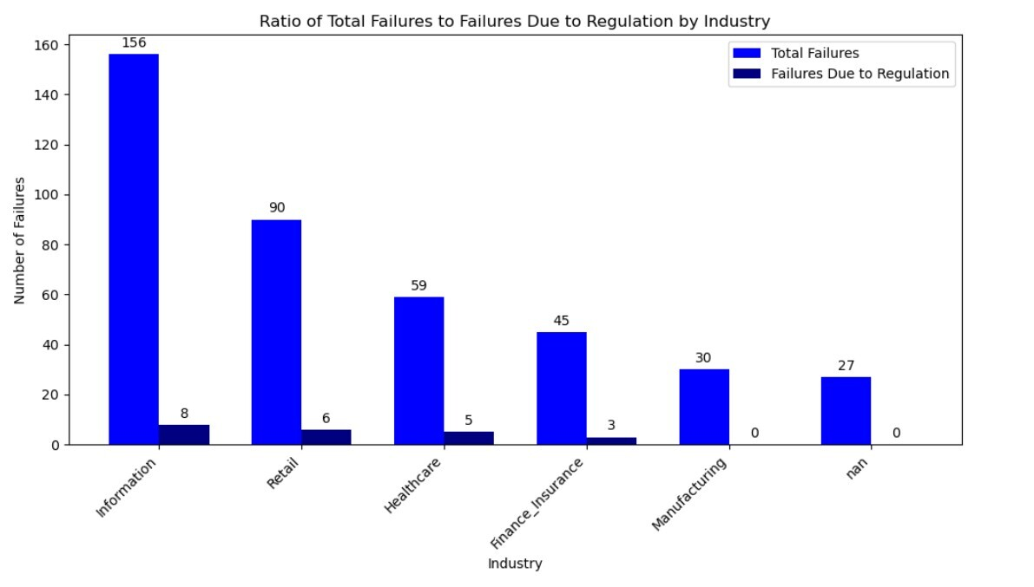
H. Nº2: Regulations (B):

Slide 8
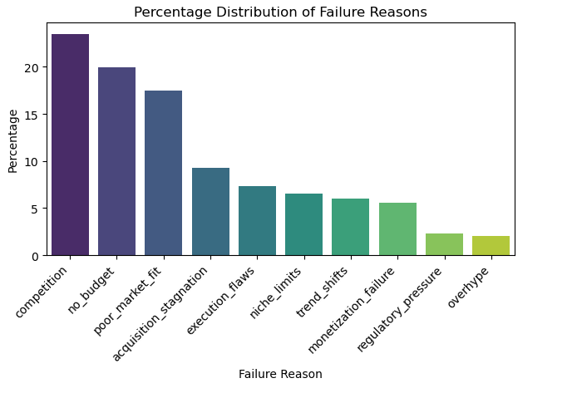
H. Nº3: Failure Reasons (A):

Slide 9
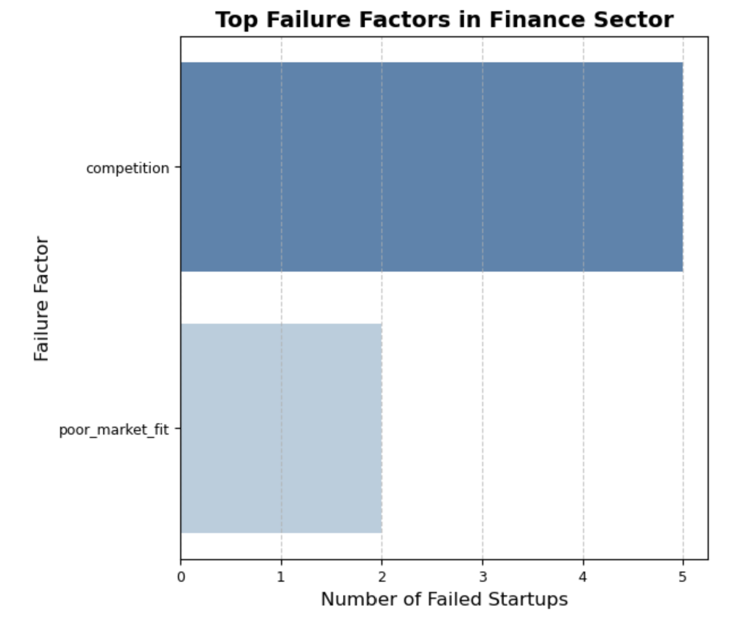
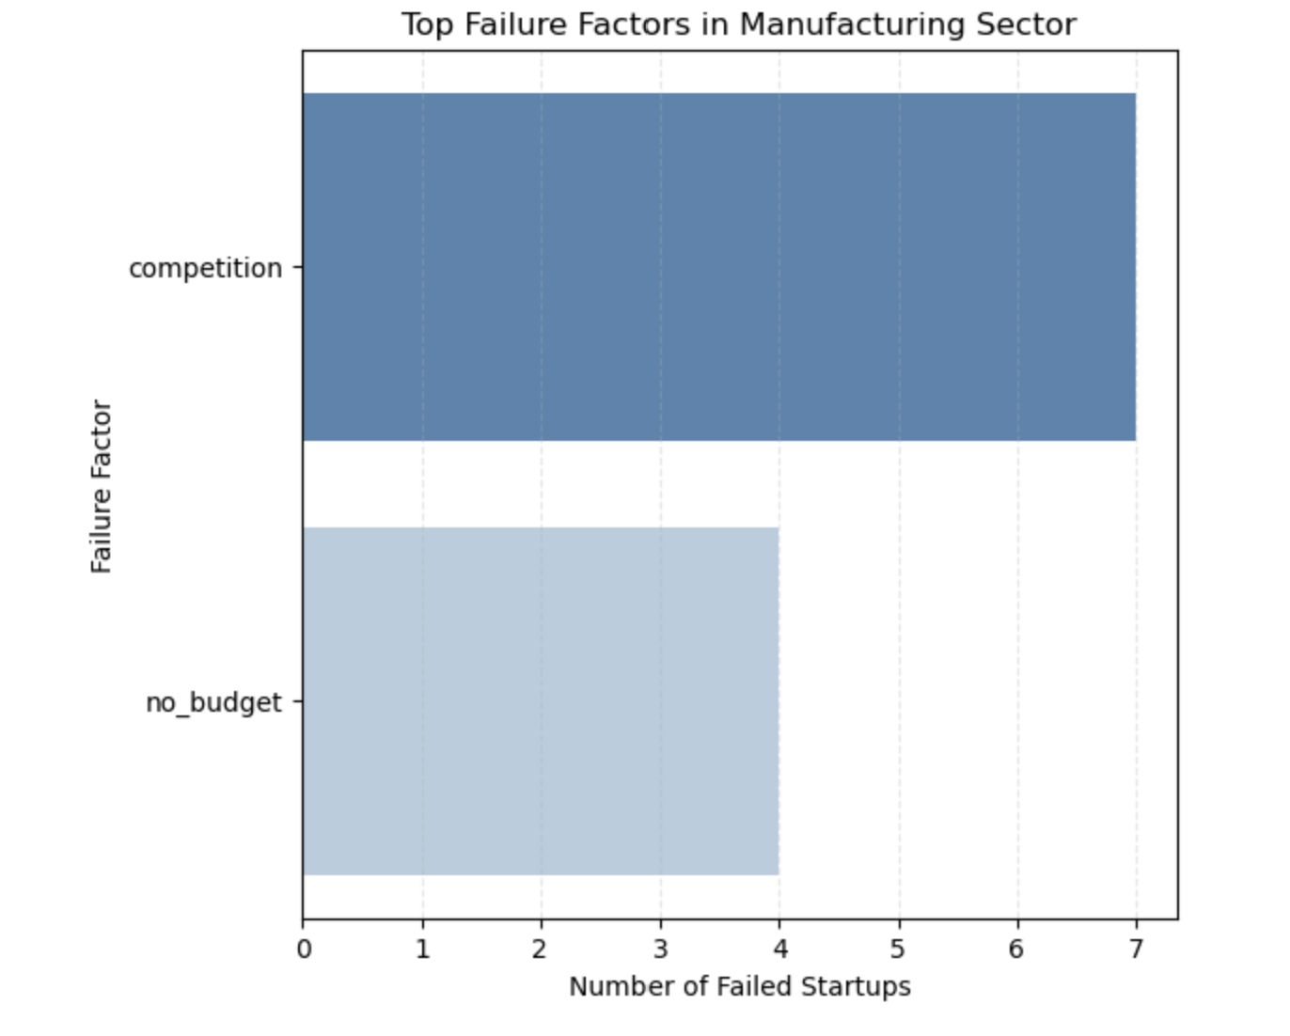
H. Nº3: Failure Reasons (B):

Slide 10
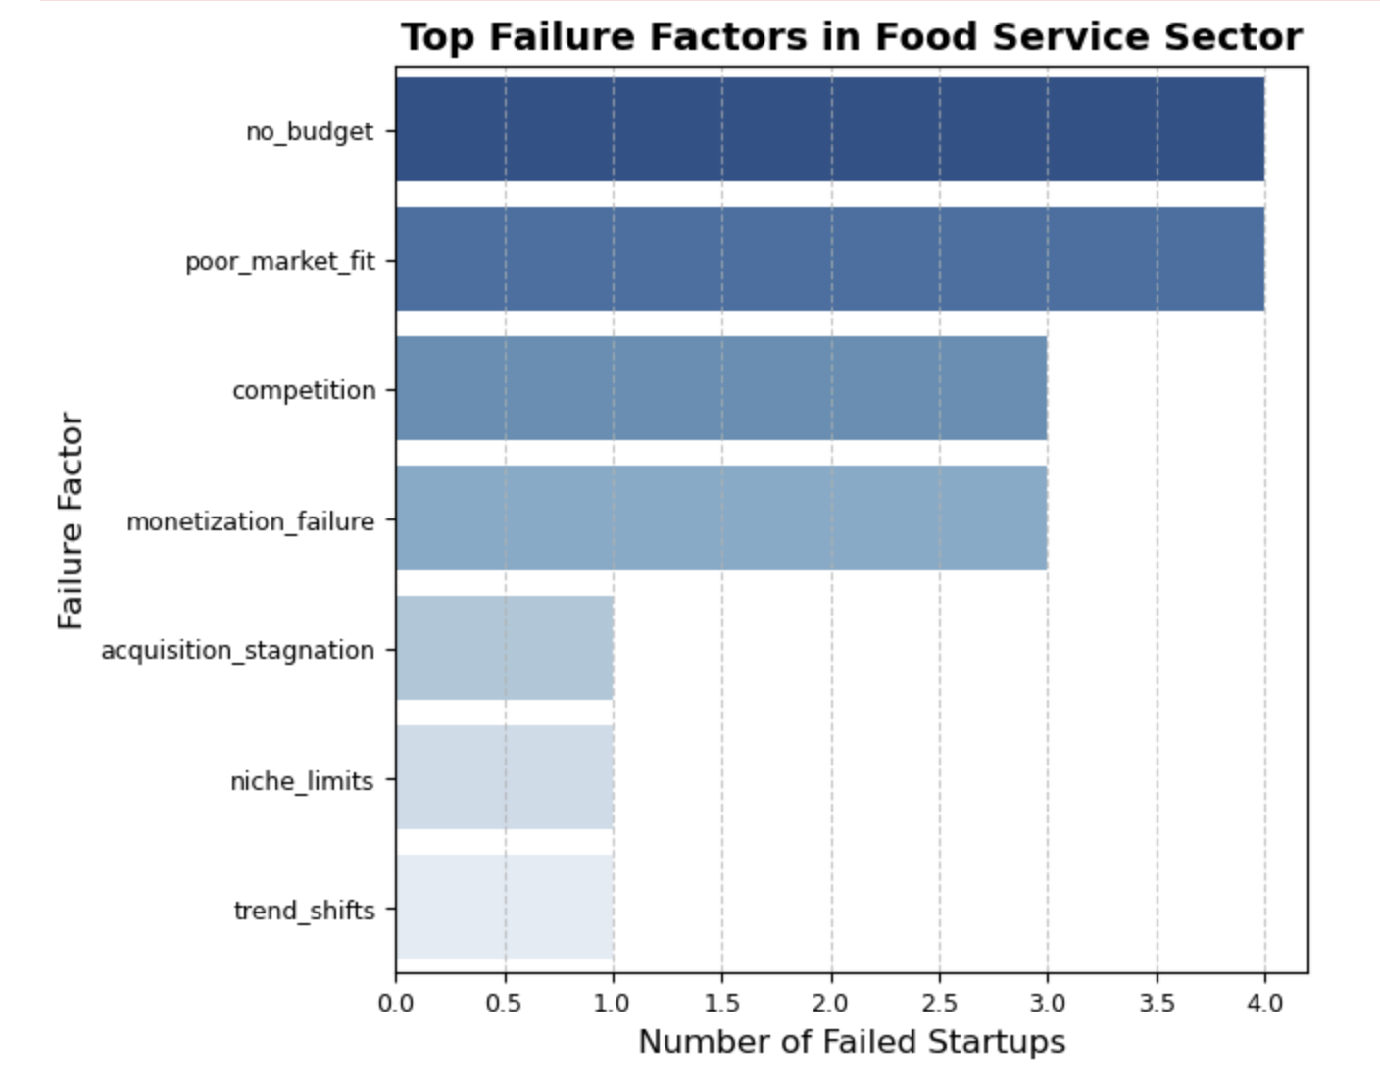
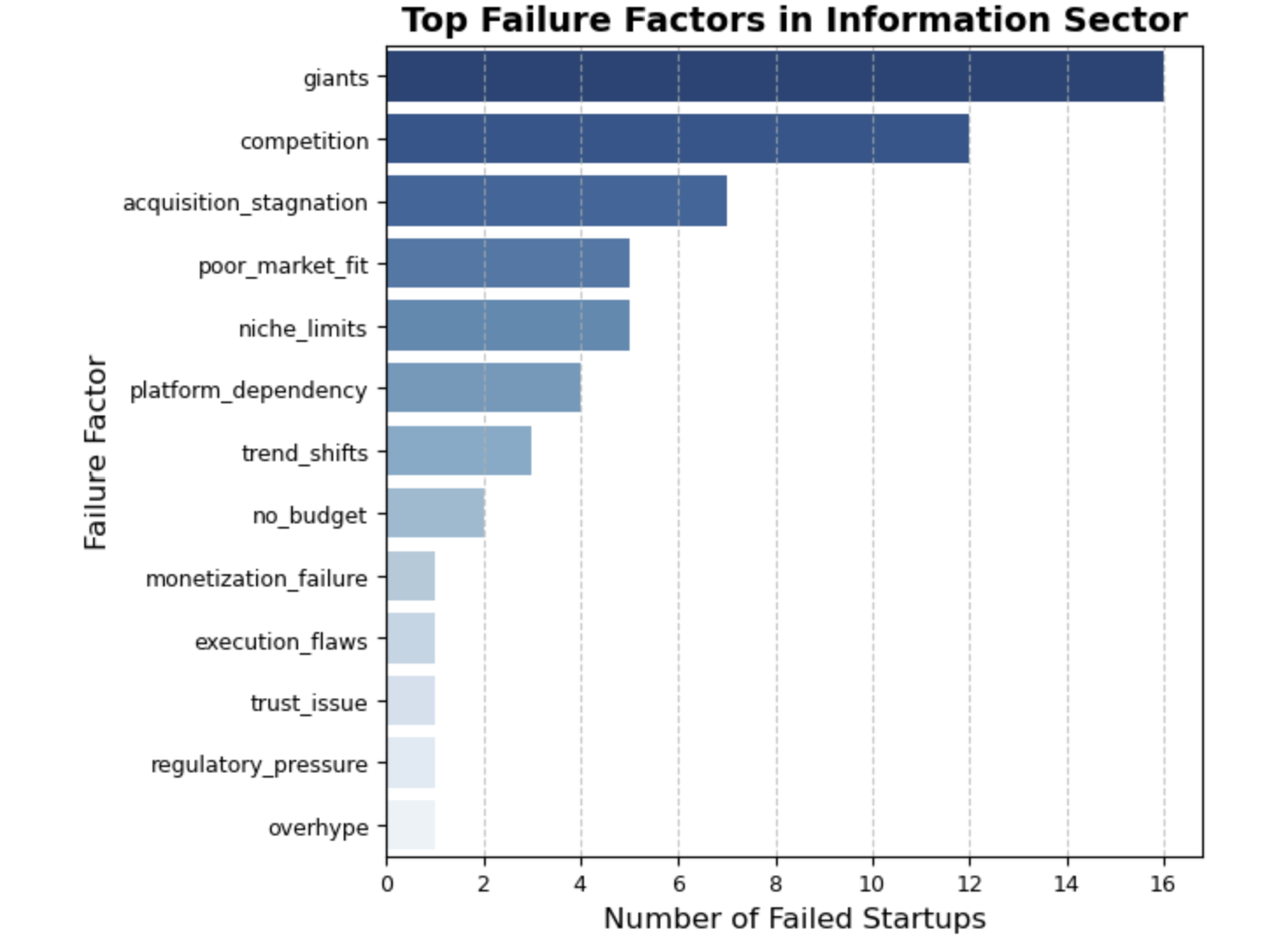
H. Nº3: Failure Reasons (C):

Slide 11
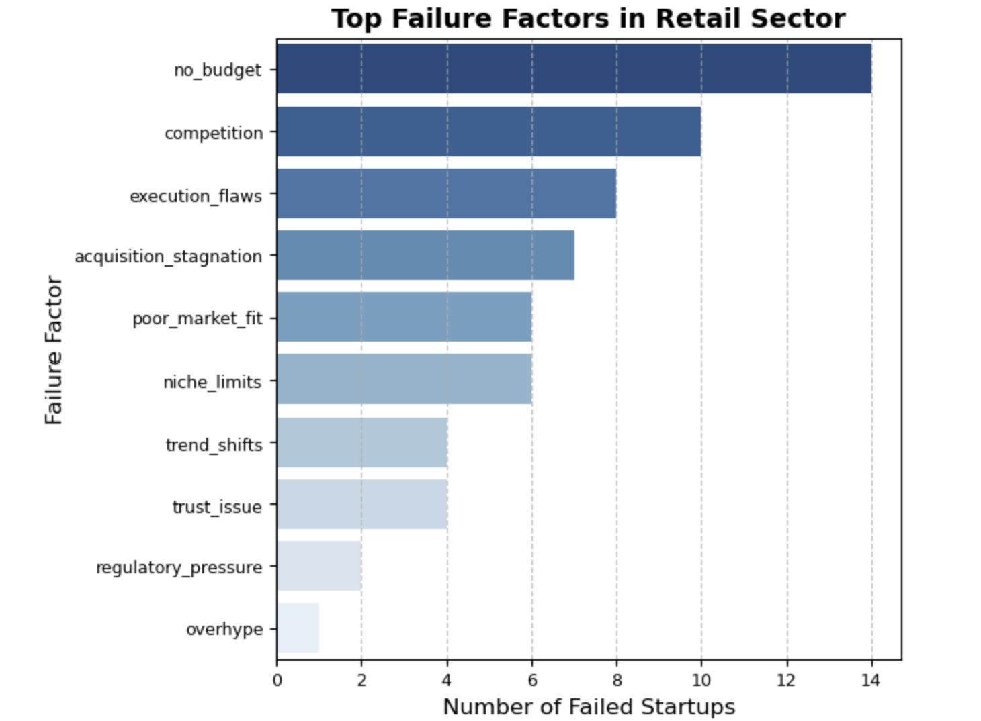
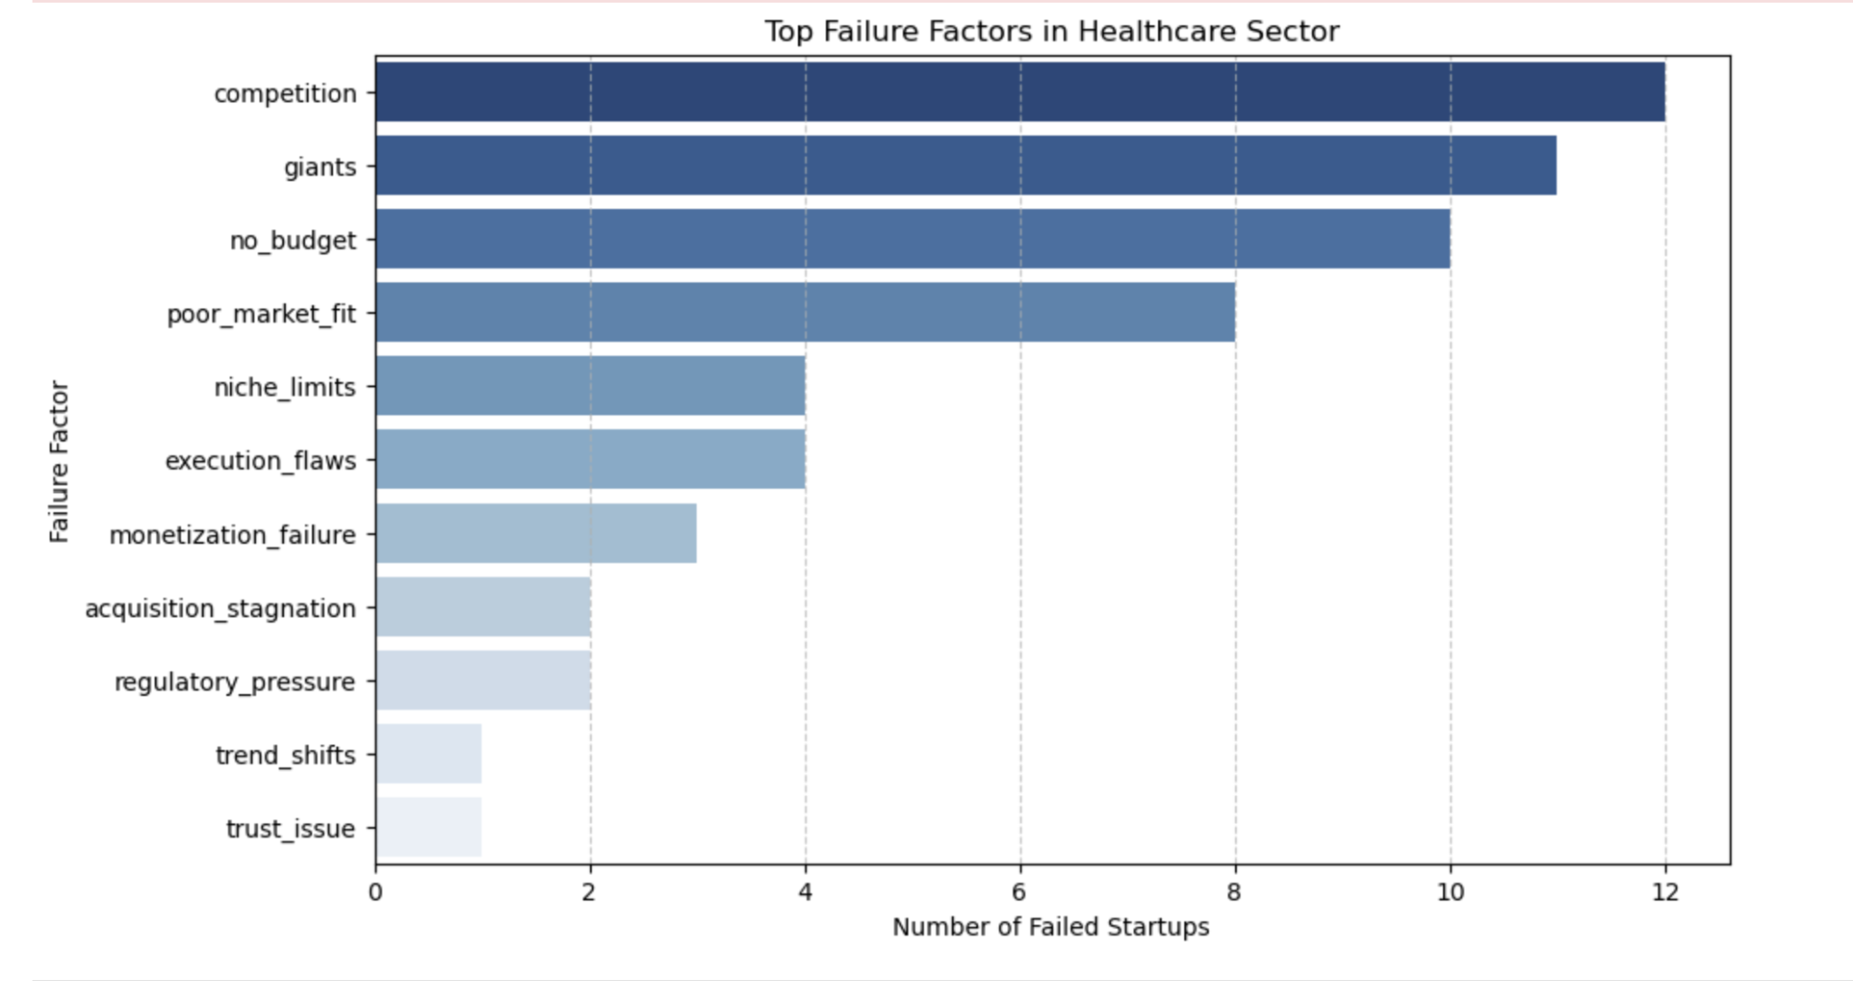
H. Nº3: Failure Reasons (C):

Slide 12
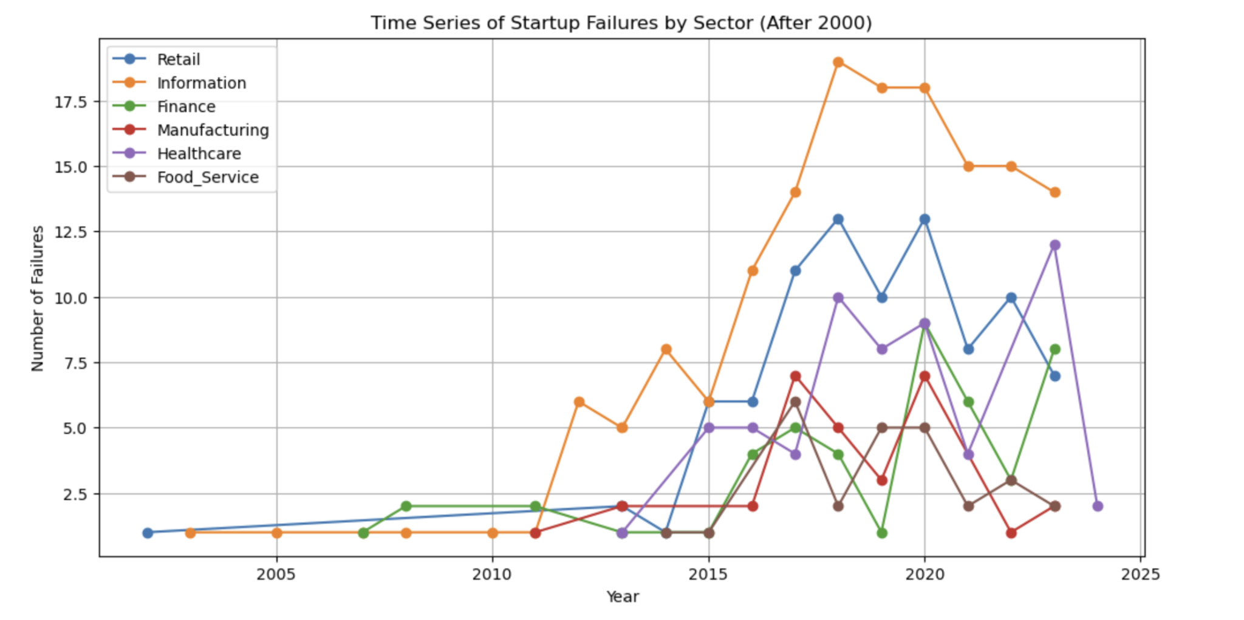
H. Nº4: Timing & Economic Conditions:

Slide 13
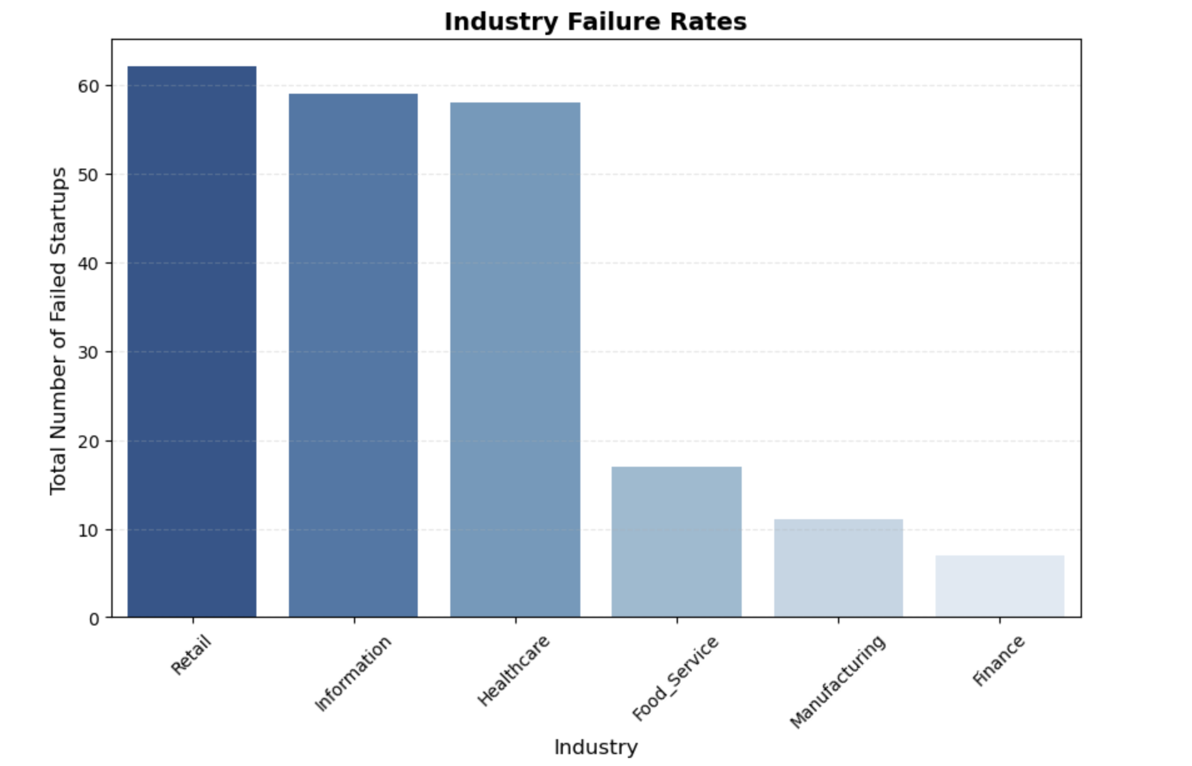
Industry Failure Rates:

Slide 14
Policy makers Needs to Shift Focus From Money to Market Readiness
Funding alone isn't enough – Startups need strategic guidance.
Sector-Specific Failures require targeted policies.
Improve mentorship & strategic funding allocation.
Support policies that encourage innovation & market stability.
Conclusion and Policy Recommendation:
📢 Quote: "Funding is a tool, not a solution. We must build a startup ecosystem, not just write checks."

Slide 15




Thank you!
Chika, Ahmad, Atefah

Slide 16
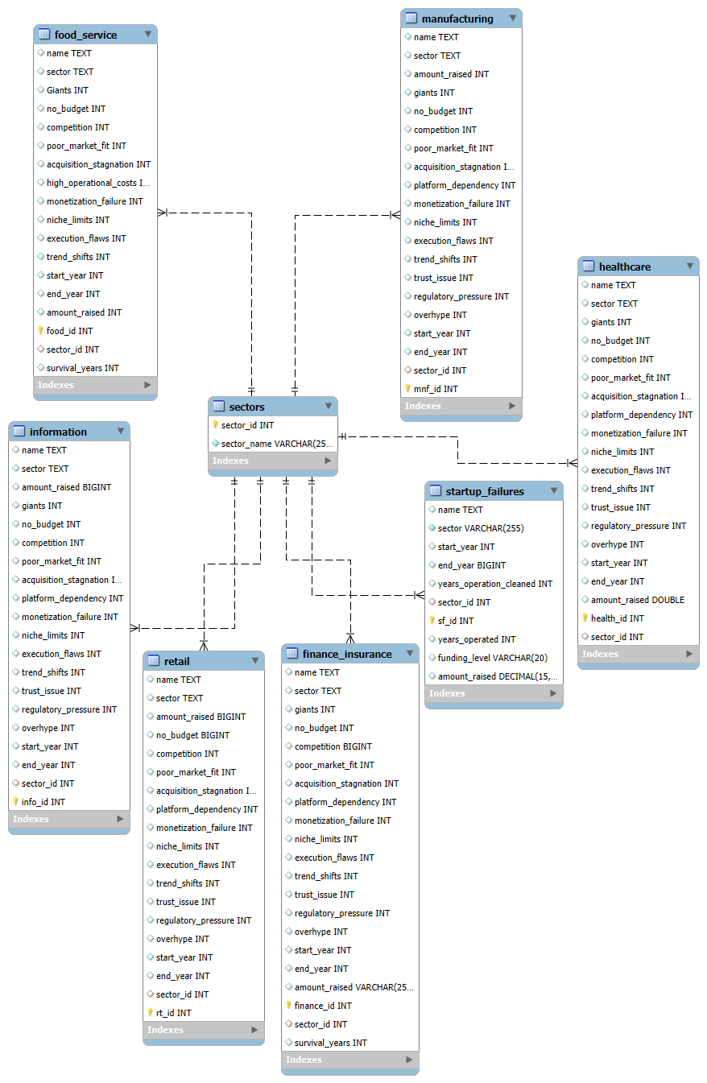
Index:
Entity-Relationship Model (ERM)
This Entity-Relationship Model (ERM) represents startup failures across multiple sectors, linking industry-specific data to a centralized sectors table. Each sector (e.g., healthcare, retail, manufacturing) has detailed attributes capturing key failure factors. The model ensures data integrity and enables cross-sector analysis by leveraging primary and foreign key relationships.

